Slide 1
Stock Trading Platform Project
Team MWP3

Slide 2
Meet The Team
Team Member | Roles
Attalla, Sara | Watchlist, live data pulling, unit test
Ijaz, Ramsha | Buy/Sell trade function, unit test
Chen, Si Ao (Michael) | Portfolio, trade history, trade processing logic
Ma, Hoi Yan (Sherry) | Graph, trading advice, live data pulling, UI

Slide 3
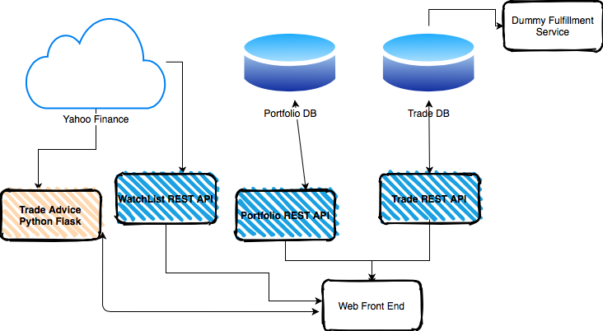

Slide 4
Technology
Java Spring Boot REST Application
Trading REST API
Portfolio REST API
Dummy Trade API (provided)
Python Flask
Trade Advice API
React.js (node.js)
User Interface

Slide 5
Trading API
Core API that allows the user to perform a trade
Add trade
Update a trade*
Get all trades
Delete trades**
Stocks are checked against real stocks; this is done by using Yahoo Finance
*Update only allowed if status is ‘CREATED’
**User cannot delete trade, function only available on server side

Slide 6

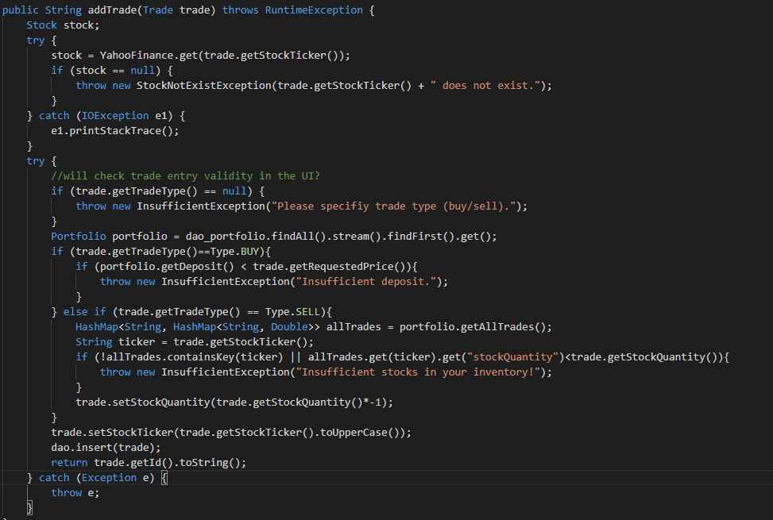
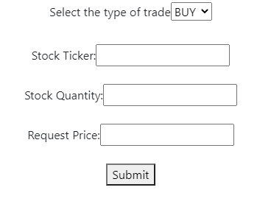
Frontend
Opens up buy/sell form
Backend

Slide 7
Trading REST API
URL | GET | POST | PATCH | DELETE
/trades | Get all trades obj | Add a trade -Body: trade obj | N/A | Delete all trades
/trades/{id} | N/A | N/A | Modify trade obj by id -Body: obj with desire changes | Delete trade by id
/trades/{ticker_name} | Get trades by ticker name | N/A | N/A | N/A

Slide 8
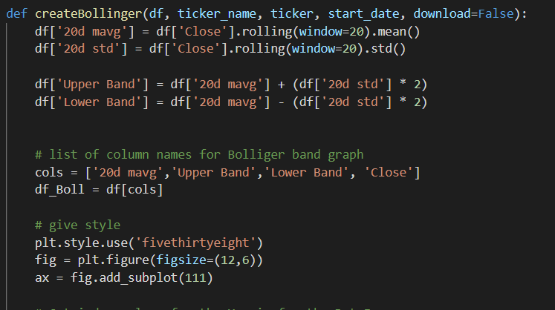
Trading Advice
Data pulled from Yahoo Finance
Retrieve Bollinger Band Data by computing the data

Slide 9
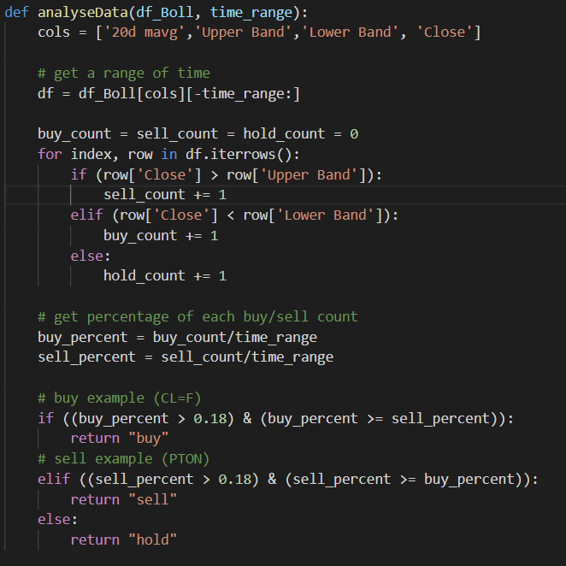
Trading Advice
Provide buy/sell advice
Observe recent 30 days trend

Slide 10
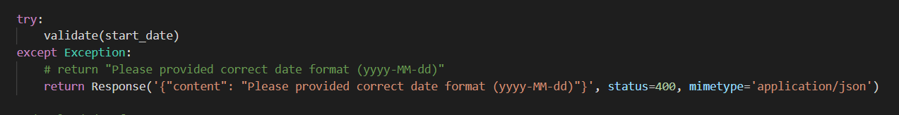
Advice REST API
GET
/check/:ticker_name
Return whether the ticker name exist (validation)
/download/:ticker_name/:start_date
Return Bollinger Band image.png (for download purpose)
/plain/:ticker_name/:start_date
Return JSON of Bollinger Band graph data
/:ticker_name
Return advice of a certain stock
Corresponding response status is send (200, 400, 404)

Slide 11


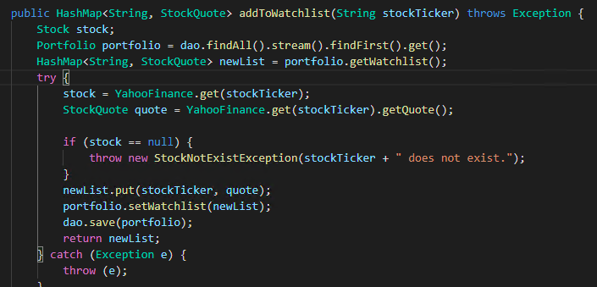
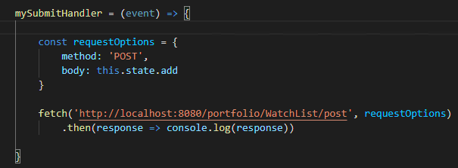

The Watch List
3
Portfolio Controller
Yahoo Finance
1
4
2
5
Portfolio DB

Slide 12
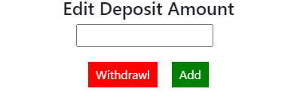
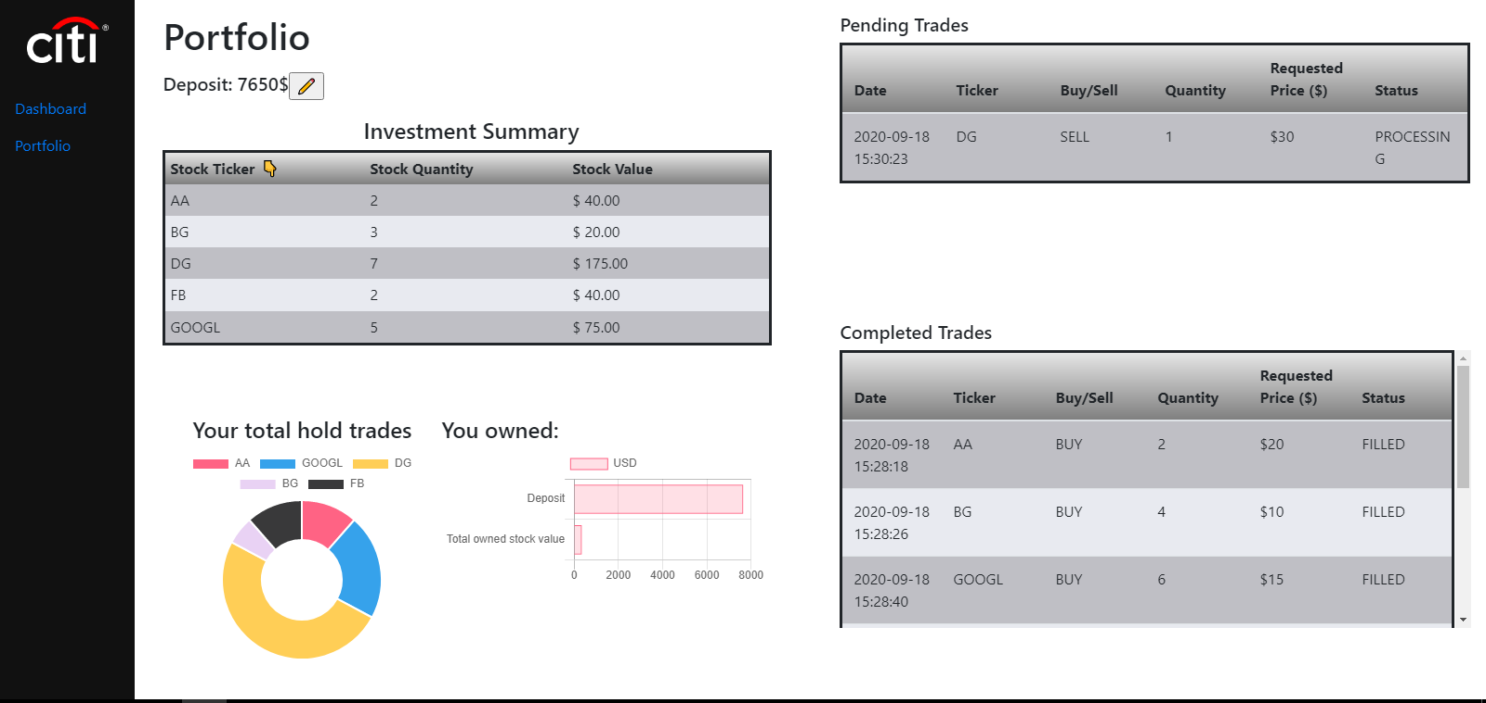
Portfolio
2
1
6
3
4
5

Slide 13
Learning Outcomes Achieved
Learned the basics of full stack development and relevant technologies used.
Worked with databases
How REST APIs work, their components
Python for Data and FInancial Analysis
How frontend works with the backend
Learned react in a couple of days
Became bitbucket experts
Teamwork
Time Management

Slide 14
Future Integrations
Microservices such as dockerization
Add functionality in the UI to update a trade
Changes to architecture
More testing and seperate database for tests

Slide 15

Thank You!
Questions? Feedback?

